Slide 1


‘Enjoy and Achieve’
Welcome to
Maylandsea Primary School
Head teacher - Mrs Clare James

Slide 2
About our school
Maylandsea Primary School is one of 7 schools in the Eveleigh Link Academy Trust - all our schools have high expectations of our children and parents. We expect parents to support their children's learning e.g. with homework, parents evening and taking an interest in their education.
Maylandsea Primary School is moving towards having one class in each year group and 30 children in each class (full capacity 210). Every class has a teacher and a learning support assistant to help with maths and English each morning. The afternoons are mainly the wider curriculum (history, art, music, PE etc) Reception children have a teacher as well as a full time learning support assistant.
We have 2 large, public carparks near the school but these do get very busy. We encourage families to walk to school where possible.
We offer a variety of before and after school clubs from Y1 upwards. These may include activities such as tennis, football, gymnastics, music lessons, choir, computer, badminton, science.
Every week we email home a newsletter with dates and events happening during the school term. It also gives weekly updates of what’s been happening in school.

Slide 3
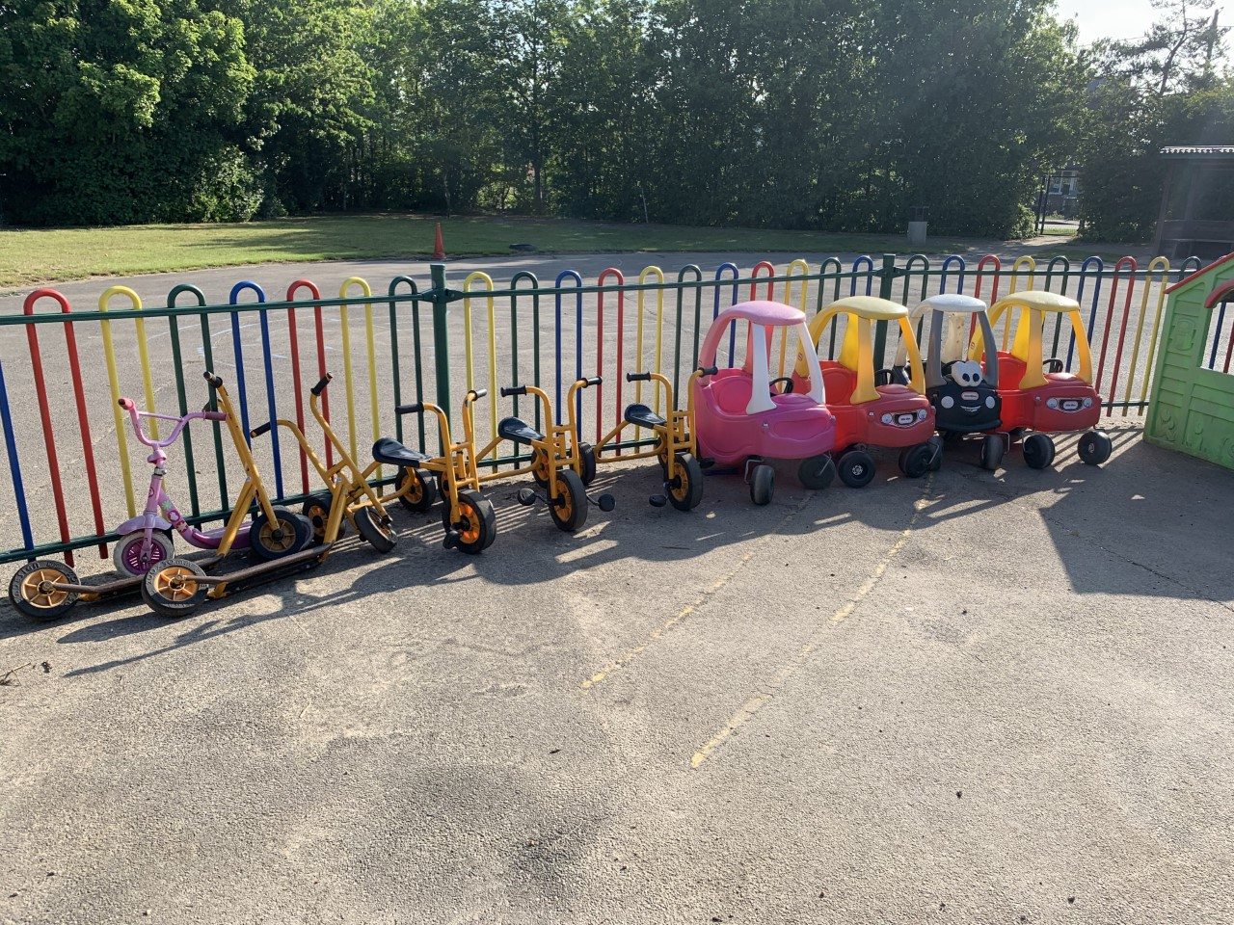
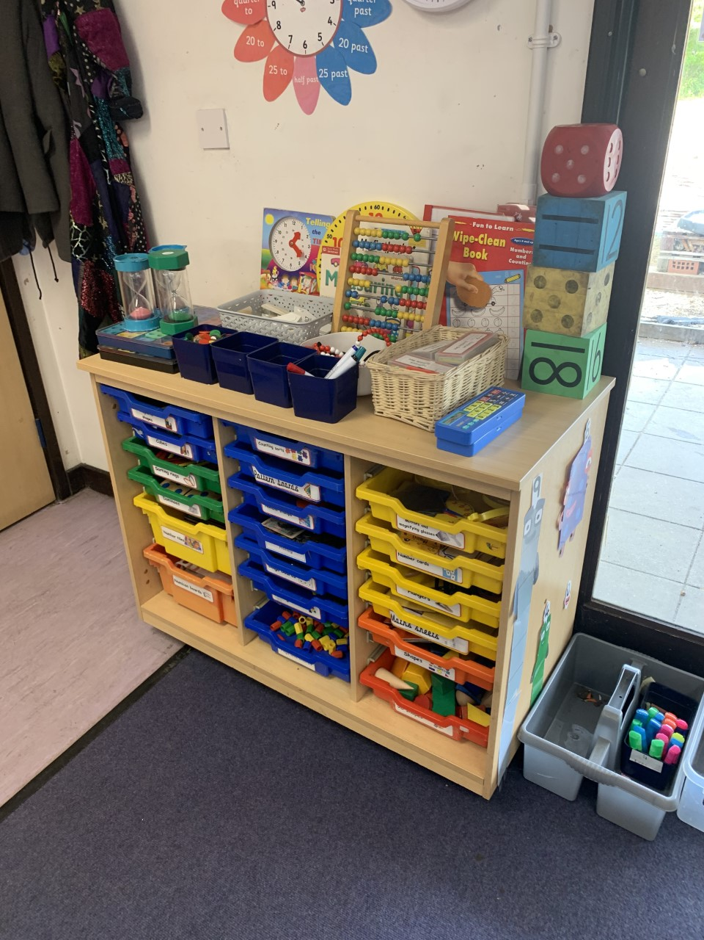
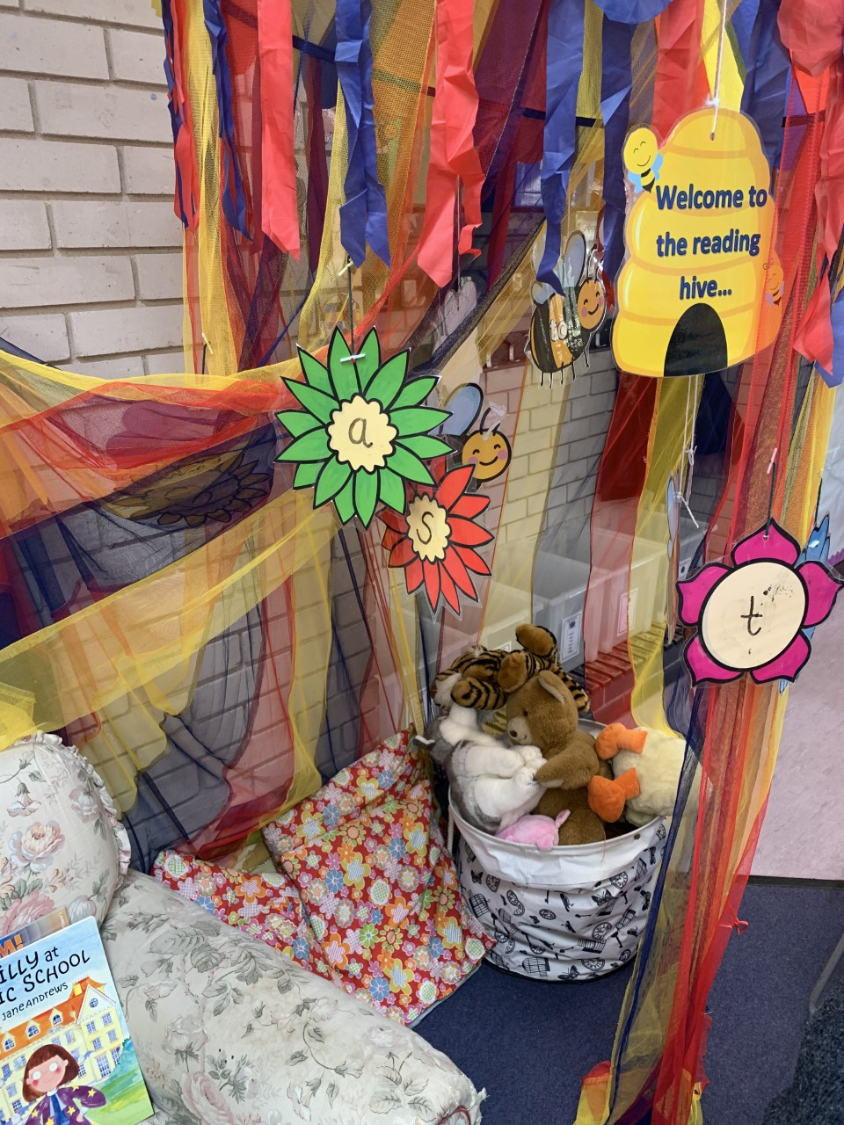
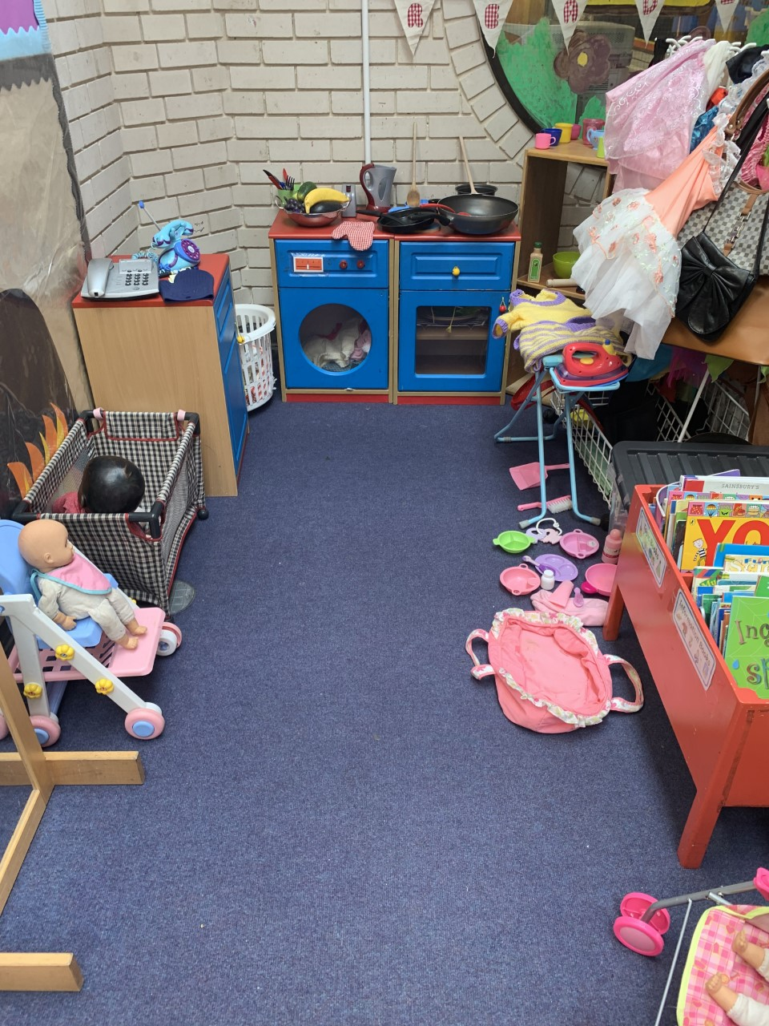
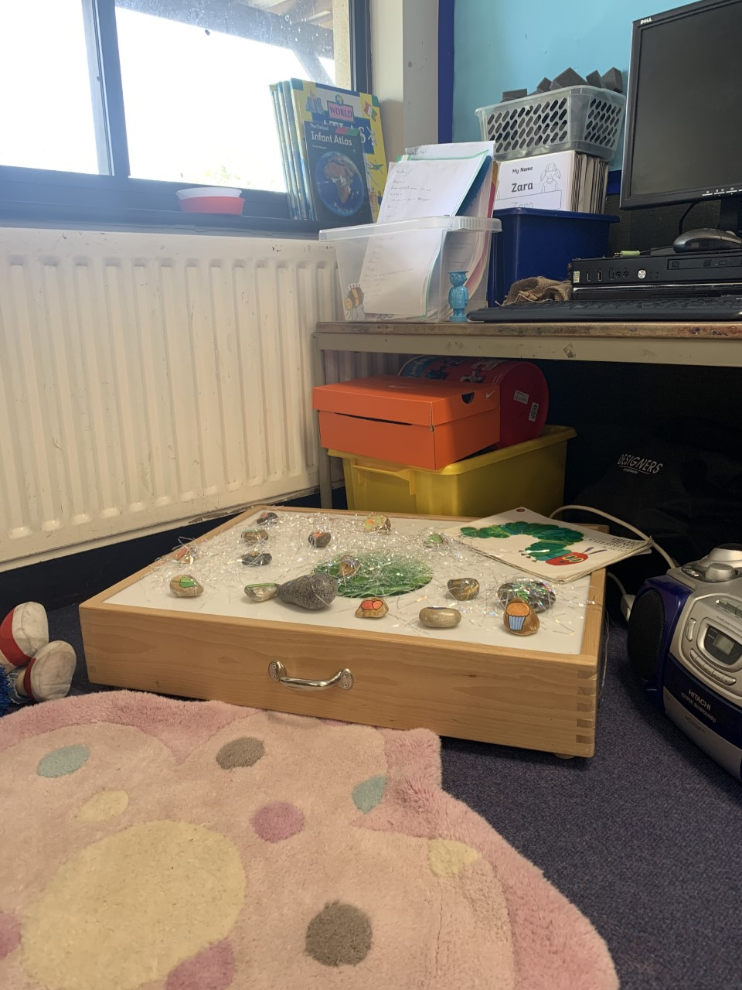
Early Years: Our curriculum is based on developing the characteristics of effective learning. We use the online system called Class Dojo to record each child’s learning journey, which parents can access too.
Playing and exploring – engagement:
Finding out and exploring
Playing with what they know
Being willing to ‘have a go’
Active learning – motivation
Being involved and concentrating
Keeping trying
Enjoying achieving what they set out to do
Creating and thinking critically – thinking
Having their own ideas
Making links
Choosing ways to do things
Free flow inside and outside. Phonics is taught as soon as the children come into reception as well as reading, writing and maths – in a fun, creative and enjoyable way

Slide 4
Applying for a place
All schools have published admission criteria set by local authority. We have places for 30 children each year, prioritised by: a) Children looked after by the local authority, b) Siblings c) straight line distance from home to school.
To apply for a place at our school, please use the link https://www.essex.gov.uk/admissions
You can apply online for your child’s primary (Reception) school place. (Date TBC)
You must submit an application by the national closing date TBC

Slide 5
Parent Tours
If you would like the opportunity to look around our school before applying for a place, please contact the school office and book one of the tour dates and times below.
Wednesday 4th November 1:30pm
Wednesday 11th November 1:30pm
Wednesday 18th November 1:30pm
Wednesday 2nd December 1:30pm

Slide 6
Our School Website
Please have a good look around our school website. You will be able to see examples of newsletters, activities and the curriculum. You will be able to find out about our school uniform for example, and read our Ofsted report and find out about our homework procedures.
The class pages will give you lots of information about the learning and how we make this interesting and meaningful.
www.maylandsea.essex.sch.uk

Slide 7
Next steps
If you have any further questions and you can’t find the information on our website, please email admin@maylandsea.essex.sch.uk and put ‘September 2027 Reception admissions question’ in the subject box’ and we will be delighted to get back to you.
If your query is more complex, we will be happy to reply to your email with a phone call.

